Slide 1
NN Kernels – Fully connected layer
Sergio Zerpa
DES SDF FW

Slide 2
Content
TFL Micro – Kernels
The Fully connected layer
TFL Micro – NN Kernels optimizations
Option 1
Option 2
Option 3
Option 4

Slide 3
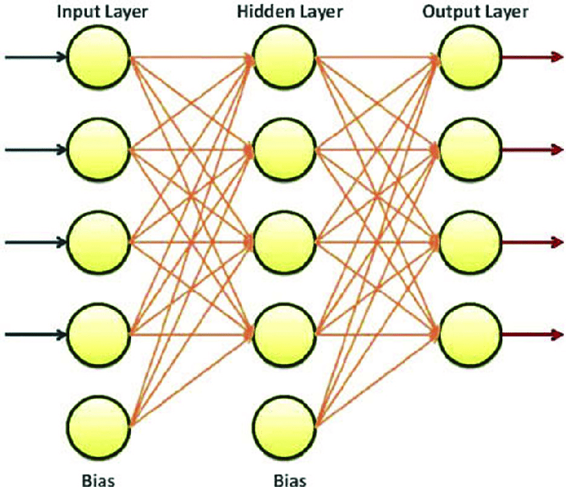
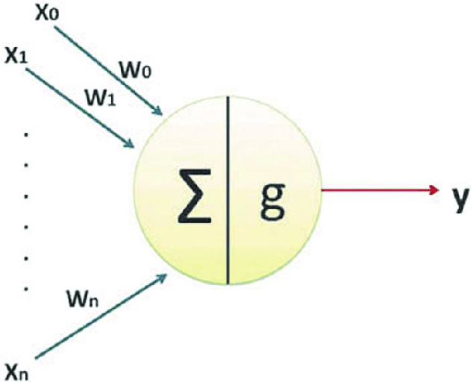

TFL Micro – Kernels - The Fully connected layer
It is basically a matrix-vector multiplication with bias.
The matrix is the weights
The input/output vectors are the activation values.
x1
w11
y1
w12
x2
y2
x3
y3
x4
y4
x1
x2
x3
x4
w11 w12 w13 w14
w21 w22 w23 w24
w31 w32 w33 w34
w41 w42 w43 w44
y1
y2
y3
y4
input-vector =
Weights =
output-vector =

Slide 4

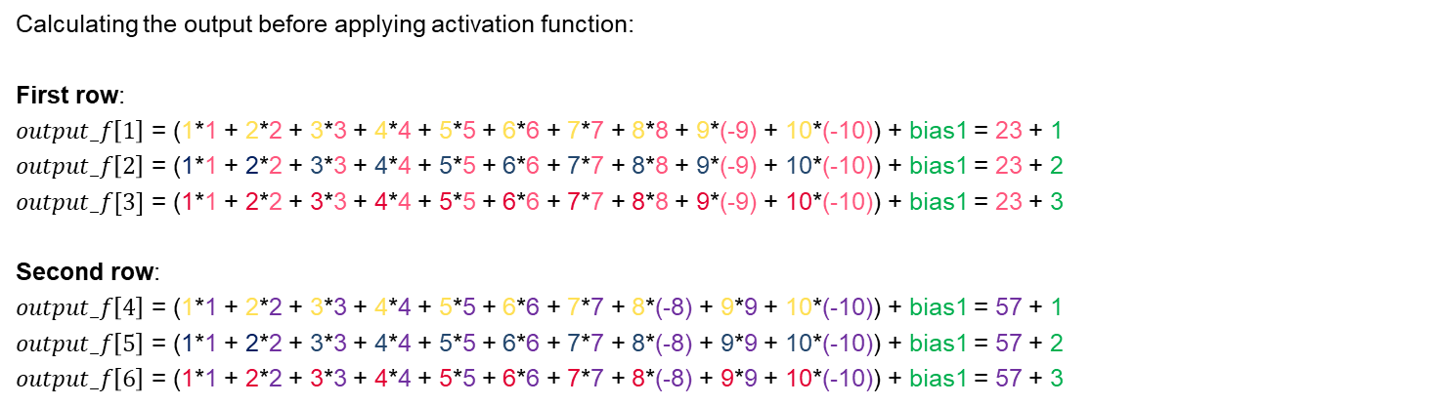
TFL Micro – Kernels - The Fully connected layer (Floating point)
input_dims = {2, 2, 10};
float input_f =
{
1, 2, 3, 4, 5, 6, 7, 8, -9, -10
1, 2, 3, 4, 5, 6, 7, -8, 9, -10
};
weights_dims = {2, 3, 10};
float weights_f =
{
1, 2, 3, 4, 5, 6, 7, 8, 9, 10
1, 2, 3, 4, 5, 6, 7, 8, 9, 10
1, 2, 3, 4, 5, 6, 7, 8, 9, 10
};
bias_dims = {1, 3};
float bias_f =
{
1, 2, 3
};
output_dims = {2, 2, 3};
float output_f =
{
(23 + 1), (23 + 2), (23 + 3)
(57 + 1), (57 + 2), (57 + 3)
};
$$output_f\left[1\right]=\sum_{i=0}^{n=accum_depth}{\left(weights_f\left[i\right]∗input_f\left[i\right]\right)+bias_f\left[1\right]}$$
Calculating the output before applying activation function:
First row:
$output_f\left[1\right]$ = (1*1 + 2*2 + 3*3 + 4*4 + 5*5 + 6*6 + 7*7 + 8*8 + 9*(-9) + 10*(-10)) + bias1 = 23 + 1
$output_f\left[2\right]$ = (1*1 + 2*2 + 3*3 + 4*4 + 5*5 + 6*6 + 7*7 + 8*8 + 9*(-9) + 10*(-10)) + bias1 = 23 + 2
$output_f[3]$ = (1*1 + 2*2 + 3*3 + 4*4 + 5*5 + 6*6 + 7*7 + 8*8 + 9*(-9) + 10*(-10)) + bias1 = 23 + 3
Second row:
$output_f\left[4\right]$ = (1*1 + 2*2 + 3*3 + 4*4 + 5*5 + 6*6 + 7*7 + 8*(-8) + 9*9 + 10*(-10)) + bias1 = 57 + 1
$output_f\left[5\right]$ = (1*1 + 2*2 + 3*3 + 4*4 + 5*5 + 6*6 + 7*7 + 8*(-8) + 9*9 + 10*(-10)) + bias1 = 57 + 2
$output_f\left[6\right]$ = (1*1 + 2*2 + 3*3 + 4*4 + 5*5 + 6*6 + 7*7 + 8*(-8) + 9*9 + 10*(-10)) + bias1 = 57 + 3
Source-code: aiml_deployment\tensorflow\tensorflow\lite\micro\kernels\fully_connected_test.cc

Slide 5
TFL Micro – Kernels - The Fully connected layer (Floating point)
input_dims = {2, 2, 10};
float input_f =
{
1, 2, 3, 4, 5, 6, 7, 8, -9, -10
1, 2, 3, 4, 5, 6, 7, -8, 9, -10
};
weights_dims = {2, 3, 10};
float weights_f =
{
1, 2, 3, 4, 5, 6, 7, 8, 9, 10
1, 2, 3, 4, 5, 6, 7, 8, 9, 10
1, 2, 3, 4, 5, 6, 7, 8, 9, 10
};
bias_dims = {1, 3};
float bias_f =
{
1, 2, 3
};
output_dims = {2, 2, 3};
float output_f =
{
(23 + 1), (23 + 2), (23 + 3)
(57 + 1), (57 + 2), (57 + 3)
};
batches = 2
batches = 2
output_depth = 3
output_depth = 3
accum_depth = 10
output_depth = 3
accum_depth = 10
batches = output_dims[0] = 2
output_depth = output_dims[1] = weights_dim[0] = 3
accum_depth = weights_dim[1] = 10
Time complexity:
O(batches*output_depth*accum_depth)
for (b = 0; b < batches; ++b)
{
for (out_c = 0; out_c < output_depth; ++out_c)
{
total = 0.f;
for (d = 0; d < accum_depth; ++d)
{
total += weights_data[out_c * accum_depth + d] * input_data[b * accum_depth + d];
}
bias_value = bias_data[out_c];
output_data[out_c + output_depth * b] = ActivationFunctionMinMax (total + bias_value, activMin, activMax);
}
}

Slide 6





TFL Micro – Kernels - The Fully connected layer (Quantized)
input_dims = {2, 2, 10};
float input_f =
{
1, 2, 3, 4, 5, 6, 7, 8, -9, -10
1, 2, 3, 4, 5, 6, 7, -8, 9, -10
};
weights_dims = {2, 3, 10};
float weights_f =
{
1, 2, 3, 4, 5, 6, 7, 8, 9, 10
1, 2, 3, 4, 5, 6, 7, 8, 9, 10
1, 2, 3, 4, 5, 6, 7, 8, 9, 10
};
bias_dims = {1, 3};
float bias_f =
{
1, 2, 3
};
output_dims = {2, 2, 3};
float output_f =
{
(23 + 1), (23 + 2), (23 + 3)
(57 + 1), (57 + 2), (57 + 3)
};
Using floating-points:
$$output_f\left[1\right]=\sum_{i=0}^{n=10}{\left(weights_f\left[i\right]∗input_f\left[i\right]\right)+bias_f\left[1\right]}=24$$
Converting input, weigths, bias and output to quantized-values (uint8)
weights_min = -63.5f;
weights_max = 64.0f;
F2Q(weights[i], -63.5f, 64.0f)
weights_offset = -127
weights_scale = 2
uint8_t weights =
{
129, 131, 133, 135, 137, 139, 141, 143, 145,147 129, 131, 133, 135, 137, 139, 141, 143, 145,147 129, 131, 133, 135, 137, 139, 141, 143, 145,147
};
output_min = -127.0f;
output_max = 128.0f;
F2Q(input[i], -127.0f, 128.0f)
Output_offset = -127
Output_scale = 1
uint8_t output =
{
151, 152, 153
185, 186, 187
};
input_min = -63.5f;
input_max = 64.0f;
F2Q(input[i], -63.5f, 64.0f)
input_offset = -127
input_scale = 2
uint8_t input =
{
129, 131, 133, 135, 137, 139, 141, 143, 109, 107
129, 131, 133, 135, 137, 139, 141, 111, 145, 107
};
F2Q32(bias[i], 0.25f)
bias_scale = 4;
int32_t bias =
{
4, 8, 12
};
$$input[i]=input_f[i]∗{input}_{scale}−{input}_{offset}$$
$$weights\left[i\right]=weight{s_}_{f\left[i\right]}∗{weights}_{scale}−weights_{offset}$$
$$bias[i]=bias_f[i]∗{bias}_{scale}$$
$$ouptut[i]=output_f[i]∗{output}_{scale}−{output}_{offset}$$
Source-code: aiml_deployment\tensorflow\tensorflow\lite\micro\kernels\fully_connected_test.cc

Slide 7
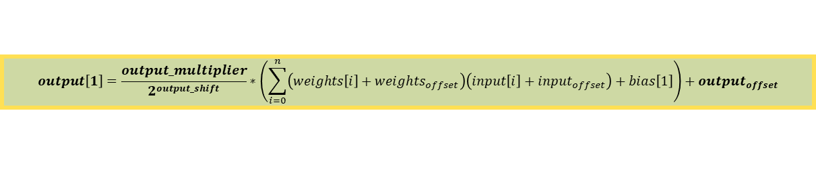
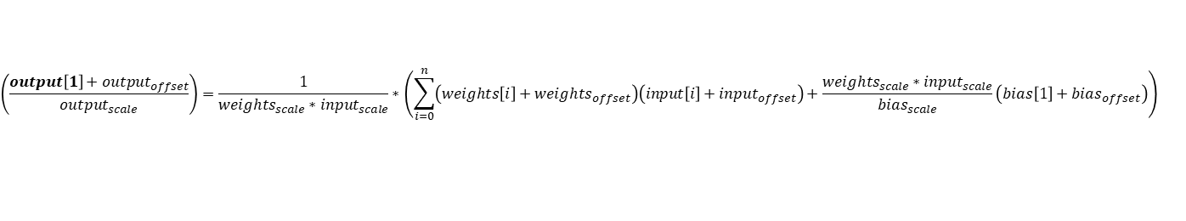
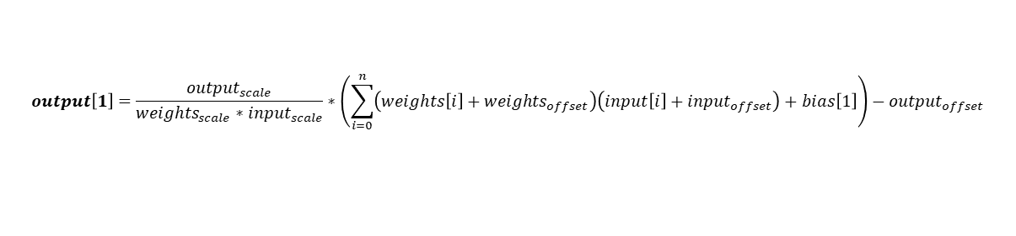
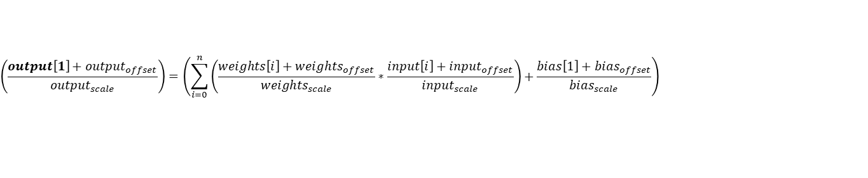
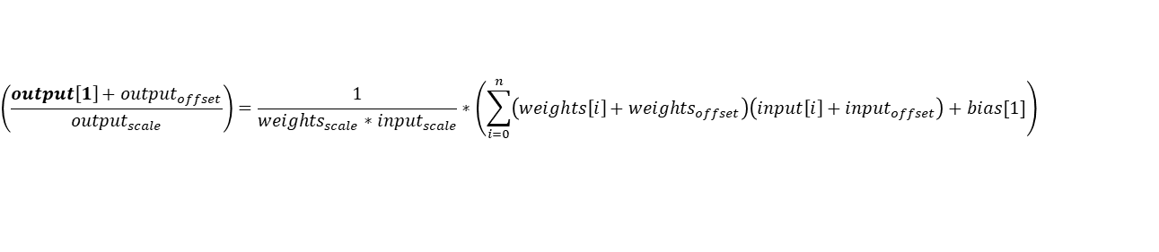



TFL Micro – Kernels - The Fully connected layer (Quantized)
Lets work on the floating-point formula to derive a formula for the quantized values:
$$output_f\left[1\right]=\sum_{i=0}^{n=accum_depth}{\left(weights_f\left[i\right]∗input_f\left[i\right]\right)+bias_f\left[1\right]}$$
$$\left(\frac{output\left[1\right]+{output}_{offset}}{{output}_{scale}}\right)=\left(\sum_{i=0}^{n}{\left(\frac{weights\left[i\right]+weights_{offset}}{{weights}_{scale}}∗\frac{input\left[i\right]+{input}_{offset}}{{input}_{scale}}\right)+\frac{bias\left[1\right]+{bias}_{offset}}{{bias}_{scale}}}\right)$$
$$\left(\frac{output\left[1\right]+{output}_{offset}}{{output}_{scale}}\right)=\frac{1}{{weights}_{scale}∗{input}_{scale}}∗\left(\sum_{i=0}^{n}{\left(weights\left[i\right]+weights_{offset}\right)\left(input\left[i\right]+{input}_{offset}\right)+\frac{{weights}_{scale}∗{input}_{scale}}{{bias}_{scale}}\left(bias\left[1\right]+{bias}_{offset}\right)}\right)$$
$${bias}_{scale}= {weights}_{scale}∗{input}_{scale}$$
Considering the bias quantization as follows:
$${bias}_{offset}=0$$
$$\left(\frac{output\left[1\right]+{output}_{offset}}{{output}_{scale}}\right)=\frac{1}{{weights}_{scale}∗{input}_{scale}}∗\left(\sum_{i=0}^{n}{\left(weights\left[i\right]+weights_{offset}\right)\left(input\left[i\right]+{input}_{offset}\right)+bias[1]}\right)$$
$$output\left[1\right]=\frac{{output}_{scale}}{{weights}_{scale}∗{input}_{scale}}∗\left(\sum_{i=0}^{n}{\left(weights\left[i\right]+weights_{offset}\right)\left(input\left[i\right]+{input}_{offset}\right)+bias\left[1\right]}\right)−{output}_{offset}$$
Finally, lets assume:
The scales-multiplier is expressed using an output-multiplier and shift value
The output-offset include the minus signed already
$$output\left[1\right]=\frac{output_multiplier}{2^{output_shift}}∗\left(\sum_{i=0}^{n}{\left(weights\left[i\right]+weights_{offset}\right)\left(input\left[i\right]+{input}_{offset}\right)+bias\left[1\right]}\right)+{output}_{offset}$$

Slide 8
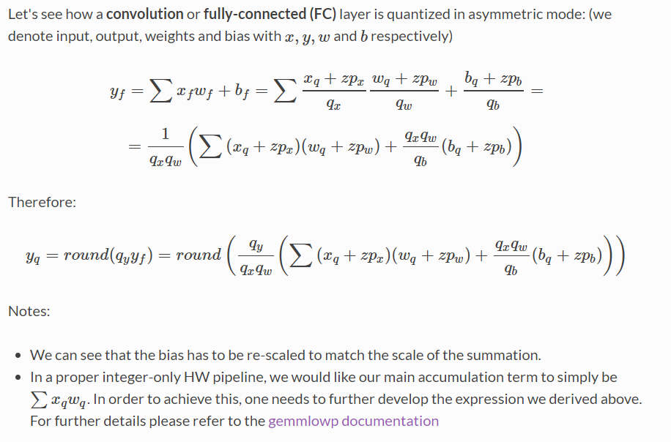
TFL Micro – Kernels - The Fully connected layer (Asymmetric quantization)
https://nervanasystems.github.io/distiller/algo_quantization.html

Slide 9
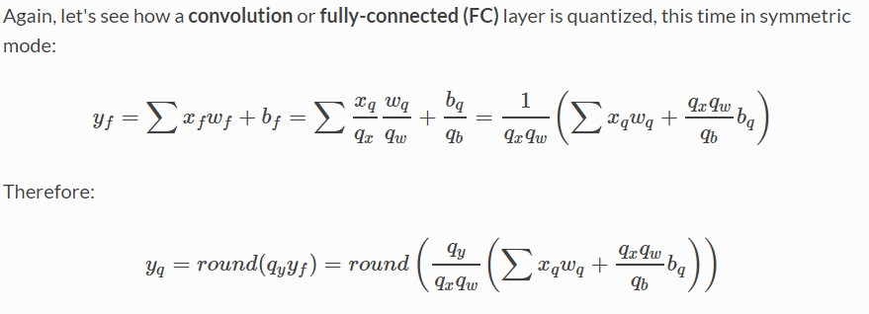
TFL Micro – Kernels - The Fully connected layer (Symmetric quantization)
https://nervanasystems.github.io/distiller/algo_quantization.html

Slide 10
TFL Micro – Kernels - The Fully connected layer (Quantized)
weights_dims = {2, 3, 10};
uint8_t weights =
{
129, 131, 133, 135, 137, 139, 141, 143, 145,147, 129, 131, 133, 135, 137, 139, 141, 143, 145,147, 129, 131, 133, 135, 137, 139, 141, 143, 145,147
};
input_dims = {2, 2, 10};
uint8_t input =
{
129, 131, 133, 135, 137, 139, 141, 143, 109, 107,
129, 131, 133, 135, 137, 139, 141, 111, 145, 107
};
bias_dims = {1, 3};
int32_t bias =
{
4, 8, 12
};
output_dims = {2, 2, 3};
uint8_t output =
{
151, 152, 153,
185, 186, 187
};
Output_depth = 3
batches = 2
batches = 2
accum_depth = 10
output_depth = 3
accum_depth = 10
Time complexity: O(batches*output_depth*accum_depth)
Information calculated fron the data above:
weight_offset = -127
input_offset = -127
output_offset = -(-127)
The scaling factors (from input, weights and bias) are used to calculate:
output_multiplier: a quantized-multiplier
output_shift: a left shift
Which is equivalent to a
S = output_scale / (input_scale * weights_scale) = 0.25
or
S = (output_multiplier)/(2^output_shift)
for (b = 0; b < batches; ++b)
{
for (out_c = 0; out_c < output_depth; ++out_c)
{
int32 acc = 0;
//Accumulation loop
for (d = 0; d < accum_depth; ++d)
{
int32 input_value = input_data[b * accum_depth + d];
int32 weight_value = weights_data[out_c * accum_depth + d];
acc += (weight_value + weight_offset ) * (input_value + input_offset);
}
acc += bias_data[out_c];
acc = MultiplyByQuantizedMultiplier(acc,output_multiplier,output_shift);
acc += output_offset;
acc = std::max(acc, output_activation_min);
acc = std::min(acc, output_activation_max);
output_data[out_c + output_depth * b] = static_cast<uint8>(acc);
}
For the first output element:
Acc = (129 + (-127))*(129 +(-127)) + (131 + (-127))*(131 +(-127)) + (133 + (-127))*(133 +(-127)) + (135 + (-127))*(135 +(-127)) + (137 + (-127))*(137 +(-127)) + (139 + (-127))*(139 +(-127)) + (141 + (-127))*(141 +(-127)) + (143 + (-127))*(143 +(-127)) + (145 + (-127))*(109 +(-127)) + (147 + (-127))*(107 +(-127))
Acc = (2)*(2) + (4)*(4) + (6)*(6) + (8)*(8) + (10)*(10) + (12)*(12) + (14)*(14) + (16)*(16) + (18)*(-18) + (20)*(-20) = 92
acc = acc+ bias = 92 + 4 = 96
acc = MultiplyByQuantizedMultiplier(acc, output_multiplier, output_shift) = 96 *0.25 = 24;
acc = acc + output_offset = 151

Slide 11
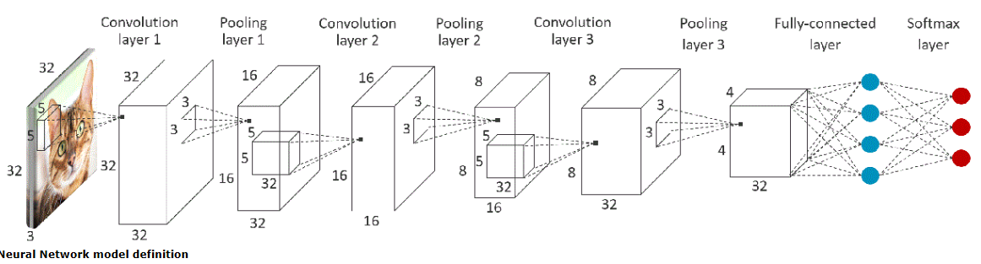
TFL Micro – NN Kernels optimizations Option 1
Micro Interpreter
Main Processor
Operations resolver
Trained-model loader
Micro
Interpreter
Output handler
Peripheral Y
Driver
Peripheral Y
Kernel
(Interface)
Peripheral X
Peripheral X
Driver
Input generator
Error reporter
Peripheral Z
Driver
Peripheral Z
Reference kernel
Optimized kernel
Operations Resolver
Math
(standard lib)
Optimized
Math-nn
Reference kernel
*Platform kernel
Math
(standard lib)
NN-Math
Microcontroller device
Invoke
(after setting new input)!
Load
Trained-model
Init
Prepare
Eval
Take advantage of the interpreter‘s Prepare phase to pre-compute factors that depend only on the model and not on the new input.
Prepare:
Pre-calculate factors that only depend on the weights and biases in the model
Allocate memory to store those factors (i.e. this requires extra-memory resources)
Inference:
Calculate factors that depend on new-input
Combine results with the pre-computed factors

Slide 12
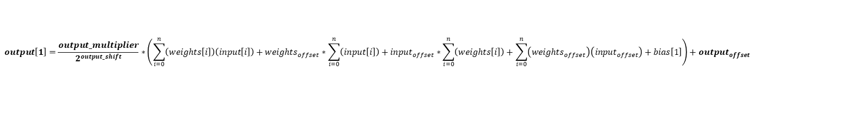
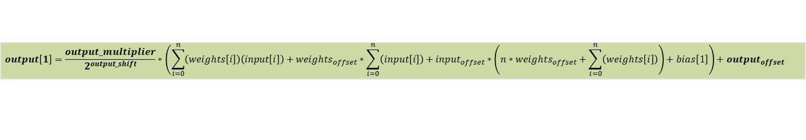
TFL Micro – NN Kernels optimizations Option 1
weights_dims = {2, 3,10};
int8_t weights =
{
1, 3, 5, 7, 9, 11, 13, 15, 17, 19,
1, 3, 5, 7, 9, 11, 13, 15, 17, 19,
1, 3, 5, 7, 9, 11, 13, 15, 17, 19
};
input_dims = {2, 2, 10};
int8_t input =
{
1, 3, 5, 7, 9, 11, 13, 15, -19, -21
1, 3, 5, 7, 9, 11, 13, -17, 17, -21
};
bias_dims = {1, 3};
int32_t bias =
{
4, 8, 12
};
output_dims = {2, 2, 3};
int8_t output =
{
23, 24, 25,
57, 58, 59
};
batches = 2
batches = 2
Output_depth = 3
output_depth = 3
accum_depth = 10
accum_depth = 10
An output element is calculated as follows:
$$output\left[1\right]=\frac{output_multiplier}{2^{output_shift}}∗\left(\sum_{i=0}^{n=accum_depth}{\left(weights\left[i\right]+weights_{offset}\right)\left(input\left[i\right]+{input}_{offset}\right)+bias\left[1\right]}\right)+{output}_{offset}$$
$$output\left[1\right]=\frac{output_multiplier}{2^{output_shift}}∗\left(\sum_{i=0}^{n}{\left(weights\left[i\right]\right)\left(input\left[i\right]\right)}+weights_{offset}∗\sum_{i=0}^{n}{\left(input\left[i\right]\right)}+{input}_{offset}∗\sum_{i=0}^{n}{\left(weights\left[i\right]\right)}+\sum_{i=0}^{n}{\left(weights_{offset}\right)\left({input}_{offset}\right)+bias\left[1\right]}\right)+{output}_{offset}$$
Which require the following calculations:
Sum-of-inputs
Sum-of-weights
$$output\left[1\right]=\frac{output_multiplier}{2^{output_shift}}∗\left(\sum_{i=0}^{n}{\left(weights\left[i\right]\right)\left(input\left[i\right]\right)}+weights_{offset}∗\sum_{i=0}^{n}{\left(input\left[i\right]\right)}+{input}_{offset}∗\left(n∗weights_{offset}+\sum_{i=0}^{n}{\left(weights\left[i\right]\right)}\right)+bias\left[1\right]\right)+{output}_{offset}$$
Sum-of-inputs-factor
*Zero, if weights_offset is zero
* or it could be calculated once
outside the accumulation-loop, and then be used in the calculation of the next output elements in the same row.
Sum-of-weights-factor (including bias)
*Remain the same per inference invokation and can be pre-calculated during ‚Prepare‘
*Additional temporal memory is needed
New-input-factor
calculated when applying inference to the input.
int32_t tmp = {x1, x2, x3 };
output_depth = 3

Slide 13
TFL Micro – NN Kernels optimizations Option 1
Running the fully connected layer using a non-optimized version (default version) and an opimized-version (using option 1 from above):
Non-optimized:
make TARGET=ifx_riscv32_mcu -j8 test_kernel_fully_connected_performance_test
Optimized:
make TAGS=portable_optimized TARGET=ifx_riscv32_mcu -j8 test_kernel_fully_connected_performance_test
weights_dims = {2, 64,128};
int8_t weights =
{
…
….
….
};
input_dims = {2, 32, 128};
int8_t input =
{
…
…
};
bias_dims = {1, 64};
int32_t bias =
{
...
};
output_dims = {2, 32, 64};
int8_t output =
{
...
...
};
Output_depth = 64
batches = 32
batches = 32
accum_depth = 128
output_depth = 64
accum_depth = 128
output_depth = 64
Load
Trained-model
Init
Prepare
Inference
New-input!
Extra-memory (256 bytes)
The optimizations improve performance by 50% but it requires extra memory for pre-computations.
dims = {1, 64};
int32_t sum_of_weights_factor =
{
...
};
output_depth = 64

Slide 14
TFL Micro – NN Kernels optimizations Option 1
Results when performing 1000 invokations for different data dimensions:

Slide 15
TFL Micro – NN Kernels optimizations Option 1 + loop-unrolling
Adding loop-unrolling manually:
By calculating two output nodes at a time, as we traverse the weights and input
weights_dims = {2, 3,10};
int8_t weights =
{
1, 3, 5, 7, 9, 11, 13, 15, 17, 19,
1, 3, 5, 7, 9, 11, 13, 15, 17, 19,
1, 3, 5, 7, 9, 11, 13, 15, 17, 19
};
input_dims = {2, 2, 10};
int8_t input =
{
1, 3, 5, 7, 9, 11, 13, 15, -19, -21
1, 3, 5, 7, 9, 11, 13, -17, 17, -21
};
bias_dims = {1, 3};
int32_t bias =
{
4, 8, 12
};
output_dims = {2, 2, 3};
int8_t output =
{
23, 24, 25,
57, 58, 59
};
batches = 2
batches = 2
Output_depth = 3
output_depth = 3
accum_depth = 10
calculateTwoOutputNodes(...)
{
// Multiply and accumulate
int32_t accum[2];
MultiplyAccumulateTwo(weights, input, accum, weights_offset, input_offset, accum_depth);
// Add bias
accum[0] += bias[0];
accum[1] += bias[1];
// Quantize down
accum[0] = MultiplyByQuantizedMultiplier(accum[0], output_multiplier, output_shift);
accum[1] = MultiplyByQuantizedMultiplier(accum[1], output_multiplier, output_shift);
// Add offset
accum[0] += output_offset;
accum[1] += output_offset;
// Clamp the result
accum[0] = min(max(accum[0], activation_min), activation_max);
accum[1] = min(max(accum[1], activation_min), activation_max);
//Set ouput
output[0] = static_cast<int8_t>(accum[0]);
output[1] = static_cast<int8_t>(accum[1]);
}
accum_depth = 10
input_ptr = input_data
output_ptr = output_data
for (b = 0; b < batches; ++b)
{
weights_ptr = weights_data
bias_ptr = bias_data
for (out_c = 0; out_c < output_depth; out_c +=2)
{
//Accumulation loop inside calculation of output nodes
calculateTwoOutputNodes(...);
weights_ptr += 2 * accum_depth
bias_ptr += 2
output_ptr += 2
}
if (output_depth % 2)
{
calculateOneOutputNode(...);
output_ptr++;
}
input_ptr += accum_depth;
}

Slide 16
TFL Micro – NN Kernels optimizations Option 1 + loop-unrolling
Adding loop-unrolling by using compiler flags, such as:
-funroll-all-loops
Force the unrolling of all loops in the code, therefore it might decrease performance.
-funroll-loops
Unroll loops whose number of iterations can be determined at compile time or upon entry to the loop
the compiler heuristically decides which loops to unroll
Note that:
none of the –O options add –funrol-loops or –funroll-all-loops
Loop unrolling increases code-size
Loop unrolling flags do not always improve performance or might even decrease performance
It has to be clarified whether those flags work, under the following conditions:
The compiler can't predict the exact amount of iterations of the loop at compile time.
The loops bounds are variable

Slide 17
TFL Micro – NN Kernels optimizations Option 1 + loop-unrolling
Using the loop-unrolling flag improves performance by 22% but increases the code-size by 14%.

Slide 18
TFL Micro – NN Kernels optimizations Option 1 + loop-unrolling (Hello world test)
Without compiler flags for loop-unrolling
Code-size: 737KB
Runtime: 51984 instructions in 0.00s 14848329 inst/s
With compiler flag -funroll-loops
Code-size: 863KB
Runtime: 51230 instructions in 0.00s 25615000 inst/s
With compiler flag -funroll-all-loops
Code-size: 866KB
Runtime: 51206 instructions in 0.00s 20539911 inst/s
Using the loop-unrolling flags improves performance by 1,4% but increases the code-size by 14%.

Slide 19
TFL Micro – NN Kernels optimizations Option 2
Micro Interpreter
Main Processor
Operations resolver
Trained-model loader
Micro
Interpreter
Output handler
Peripheral Y
Driver
Peripheral Y
Kernel
(Interface)
Peripheral X
Peripheral X
Driver
Input generator
Error reporter
Peripheral Z
Driver
Peripheral Z
Reference kernel
Optimized kernel
Operations Resolver
Math
(standard lib)
Optimized
Math-nn
Reference kernel
*Platform kernel
Microcontroller device
Math
(standard lib)
NN-Math
Load
Trained-model
Init
Prepare
Eval
Invoke
(after setting new input)
Introduce an offline-interpreter to pre-compute factors that depend only on the model and not on the new input.
Offline:
Pre-calculate factors that only depend on the weights and biases in the model
Store those factors as meta-data which shall be provide it together with the model.
Extend the interpreter kernel operations to correctly interpret the meta data
Inference:
Perform the operation accordingly, using the model, meta data and new input data.

Slide 20
TFL Micro – NN Kernels optimizations Option 3
Micro Interpreter
Main Processor
Operations resolver
Trained-model loader
Micro
Interpreter
Output handler
Peripheral Y
Driver
Peripheral Y
Kernel
(Interface)
Peripheral X
Peripheral X
Driver
Input generator
Error reporter
Peripheral Z
Driver
Peripheral Z
Reference kernel
Optimized kernel
Operations Resolver
Math
(standard lib)
Optimized
Math-nn
Reference kernel
*Platform kernel
Microcontroller device
Math
(standard lib)
NN-Math
Load
Trained-model
Init
Prepare
Eval
Invoke
(after setting new input)
Take advantage of the sparsity of the matrices in the model, which requires:
Introduce a variant of the kernel-operations to operate on sparse-inputs and sparse-weights
Extend the interpreter kernel operations to correctly interpret the sparse-data and perform the operation accoridinly

Slide 21
TFL Micro – NN Kernels optimizations Option 4
Micro Interpreter
Main Processor
Operations resolver
Trained-model loader
Micro
Interpreter
Output handler
Peripheral Y
Driver
Peripheral Y
Kernel
(Interface)
Peripheral X
Peripheral X
Driver
Input generator
Error reporter
Peripheral Z
Driver
Peripheral Z
Reference kernel
Optimized kernel
Operations Resolver
Math
(standard lib)
Optimized
Math-nn
Reference kernel
*Platform kernel
Microcontroller device
Math
(standard lib)
NN-Math
Load
Trained-model
Init
Prepare
Eval
Invoke
(after setting new input)
Adding enhancements in Hardware to perform kernel operations efficiently
Vector instructions to accelerate matrix-vector operations

Slide 22
TFL Micro – NN Kernels optimizations Option 4
Implement hardware-dependent optimizations through the gemmlowp library
(see tensorflow/lite/micro/tools/make/downloads/gemmlowp/fixedpoint)
Fully_connected
Quantized arithmetic
(See ./tensorflow/lite /kernels/internal/common)
gemmlowp
Target
(ISA extensions - vectors)
Host
(reference implementation)

Slide 23
TFL Micro – NN Kernels optimizations Option 4 (Multiply Accumulate with ARM-Neon)
Multiply and accumulate
(i.e. 8 input-entries by 8 weights-entries from 4 different rows)
1. Init accumulators with bias
acc0 = bias[0]; acc1 = bias[1]; acc2 = bias[2]; acc3 = bias[3]
2. Load weights-offset and input-offset into a vector
int16x8_t weights_offset_vec = vdupq_n_s16(weights_offset)
int16x8_t input_offset_vec = vdupq_n_s16(input_offset)
3. Load input into vector
int16x8_t input_vec = vldrbq_s16(input)
4. Add input and input-offset vectors
int16x8_t inputWithOffset_vec = vaddq_s16(input_vec, input_offset_vec)
5. Load weights from ROW_0 into vector
int16x8_t weights_vec = vldrbq_s16(weights_row0)
6. Add weights and weights-offset vectors
int16x8_t weightsWithOffset_vec0 = vaddq_s16(weights_vec, weights_offset_vec)
7. Multiply and accumulate
acc0 = vmladavaq_s16(acc0, weightsWithOffset_vec0, inputWithOffset_vec);
8. Repeat 5, 6 and 7 for ROW1, ROW2 and ROW3
weights_vec = vldrbq_s16(weights_row1)
int16x8_t weightsWithOffset_vec1 = vaddq_s16(weights_vec, weights_offset_vec)
acc1 = vmladavaq_s16(acc1, weightsWithOffset_vec1, inputWithOffset_vec);
weights_vec = vldrbq_s16(weights_row2)
int16x8_t weightsWithOffset_vec2 = vaddq_s16(weights_vec, weights_offset_vec)
acc1 = vmladavaq_s16(acc2, weightsWithOffset_vec2, inputWithOffset_vec);
weights_vec = vldrbq_s16(weights_row3)
int16x8_t weightsWithOffset_vec3 = vaddq_s16(weights_vec, weights_offset_vec)
acc3 = vmladavaq_s16(acc3, weightsWithOffset_vec2, inputWithOffset_vec);
acc0, acc1, acc2, acc3
weights_offset_vec
input_offset_vec
input_vec
inputWithOffset_vec
weights_vec
weightsWithOffset_vec0
weightsWithOffset_vec1
weightsWithOffset_vec2
weightsWithOffset_vec3
Note: For further processing the accumulated results can be put into a int32x4_t vector
Accum_vec:
acc0
acc1
acc2
acc3

Slide 24
TFL Micro – NN Kernels optimizations Option 4 (Requantization)
// See common.h in aiml_deployment\tensorflow\tensorflow\lite\kernels\internal\
inline int32 MultiplyByQuantizedMultiplier(int32 x, int32 quantized_multiplier, int shift)
{
using gemmlowp::RoundingDivideByPOT;
using gemmlowp::SaturatingRoundingDoublingHighMul;
left_shift = shift > 0 ? shift : 0;
right_shift = shift > 0 ? 0 : -shift;
int32 ab_x2_high32 = SaturatingRoundingDoublingHighMul(x * (1 << left_shift), quantized_multiplier)
return RoundingDivideByPOT(ab_x2_high32, right_shift);
}
SaturatingRoundingDoublingHighMul: a multiply-saturate operation. Computes ((a / 2^31) * (b / 2^31)) * 2^31, which simplifies to (a * b) / 2^31. That is equivalent to two times the multiply-high operation 2 * (a * b) / 2^32. i.e:
multiply elements
double the result
return the most significant half of the result or MAX_INT32 in case of saturation
RoundingDivideByPOT: round to the nearest division by a power-of-two
(i.e. also known as rounding arithmetic right shift)
//For Arm-neon, there is a vector-operation for MultiplyByQuantizedMultiplier. i.e.:
__STATIC_FORCEINLINE int32x4_t arm_requantize_mve(const int32x4_t x, const q31_t multiplier, const q31_t shift)
{
a = vshlq_s32(x, vdupq_n_s32(LEFT_SHIFT(shift)))
b = multiplier
int32x4_t ab_x2_high32 = arm_sat_doubling_high_mult_mve(a, b);
return arm_divide_by_power_of_two_mve(ab_x2_high32, RIGHT_SHIFT(shift));
}
See also fixedpoint.h and fixedpoint_neon.h in aiml_deployment\tensorflow\tensorflow\lite\micro\tools\make\downloads\gemmlowp\fixedpoint
and https://github.com/ARM-software/CMSIS_5/blob/e94ddd691d36c208f2fd9276cc09b2c8371e13e7/CMSIS/NN/Include/arm_nnsupportfunctions.h

Slide 25
TFL Micro – NN Kernels optimizations Option 4 (Requantization)
Implementation for int32_t:
General implementation for integer-types:
inline int32_t RoundingDivideByPOT(int32_t x, int exponent)
{
// Basic division (x / 2^exponent)
int32_t result = x >> exponent;
//Rounding result
int32_t remainder_mask = (1l << exponent) - 1;
int32_t remainder = remainder_mask & x;
int32_t threshold = remainder_mask >> 1;
if (result < 0)
{
threshold++;
}
if (remainder > threshold)
{
result++;
}
return result;
}
template <typename IntegerType>
inline IntegerType RoundingDivideByPOT (IntegerType x, int exponent)
{
//Basic division
IntegerType result = ShiftRight(x, exponent);
//Adjust result for rounding
const IntegerType mask = Dup<IntegerType>((1ll << exponent) - 1);
const IntegerType remainder = BitAnd(x, mask);
const IntegerType zero = Dup<IntegerType>(0);
const IntegerType one = Dup<IntegerType>(1);
const IntegerType threshold = Add(ShiftRight(mask, 1), BitAnd(MaskIfLessThan(x, zero), one));
return Add(result, BitAnd(MaskIfGreaterThan(remainder, threshold), one));
}
For Arm-neon, there is a vector-operation:
inline int32x4_t RoundingDivideByPOT(int32x4_t x, int exponent)
{
const int32x4_t shift = vdupq_n_s32(-exponent);
const int32x4_t fixup = vshrq_n_s32(vandq_s32(x, shift), 31);
const int32x4_t fixed_up_dividend = vqaddq_s32(x, fixup);
return vrshlq_s32(fixed_up_dividend, shift);
}

Slide 26
TFL Micro – NN Kernels optimizations Option 4 (activation function)
Implementation for int32_t:
inline std::int32_t SaturatingRoundingDoublingHighMul (std::int32_t a, std::int32_t b)
{
//Check if there is overflow. In case of overflow, just return INT32_MAX (see below)
bool overflow = a == b && a == std::numeric_limits<std::int32_t>::min();
//Perform multiplication
std::int64_t a_64(a);
std::int64_t b_64(b);
std::int64_t ab_64 = a_64 * b_64;
//Calculate rounding offset to add for a right shift of 31
std::int32_t nudge = ab_64 >= 0 ? (1 << 30) : (1 - (1 << 30));
//Use only the upper 32-bits and do the double-step
std::int32_t ab_x2_high32 = static_cast<std::int32_t>((ab_64 + nudge) / (1ll << 31));
return overflow ? std::numeric_limits<std::int32_t>::max() : ab_x2_high32;
}
For Arm-neon, there is a vector-operation:
int32x4_t vqrdmulhq_n_s32 (int32x4_t a, int32_t b)

Slide 27
TFL Micro – NN Kernels optimizations Option 4 (summary of vector operations)
Supported vectors:
int16x8_t : vector containing 8 elements of type int16
int32x4_t : vector containing 4 elements of type int32
Duplicate literal value into all elements in the vector
int16x8_t vdupq_n_s16(int16_t value)
int32x4_t vdupq_n_s32(int32_t value)
Load consecutive memory-values into vector
int16x8_t vldrbq_s16(int8_t const * memoryAddress)
Addition
int16x8_t vaddq_s16(int16x8_t a, int16x8_t b)
int32x4_t vaddq_s32(int32x4_t a, int32x4_t b)
Saturating Addition (i.e. saturating the result to the signed range -2^31 ≤ x ≤ 2^31 -1)
int32x4_t vqaddq_s32(int32x4_t a, int32x4_t b)
Bitwise-And
int32x4_t vandq_s32(int32x4_t a, int32x4_t b)
Shift right by a constant
int32x4_t vshrq_n_s32(int32x4_t a, __constrange(1,32) int b)
Rounding shift left by signed-variable
int32x4_t vrshlq_s32(int32x4_t a, int32x4_t b)
Multiply and accumulate
int32_t vmladavaq_s16(int32_t accum, int16x8_t a, int16x8_t b)
Saturating rounding doubling multiply high with scalar
int32x4_t vqrdmulhq_n_s32(int32x4_t vec1, int32_t val2)
Saturating rounding doubling multiply high
int32x4_t vqrdmulhq_s32(int32x4_t a, int32x4_t b)
Maximum and minimum operations
int32x4_t vmaxq_s32(int32x4_t a, int32x4_t b)
int32x4_t vminq_s32 a, int32x4_t b)
http://infocenter.arm.com/help/index.jsp?topic=/com.arm.doc.dui0491c/BABDBBJB.html

